Slide 1
About Devstack &packstack
Junsu Kim

Slide 2
Devstack?

Slide 3
Devstack

Slide 4
Devstack
a set of scripts and utilities to quickly deploy an OpenStack cloud

Slide 5
Devstack
a set of scripts and utilities to quickly deploy an OpenStack cloud

Slide 6
Devstack
a set of scripts to deploy an OpenStack cloud

Slide 7
Devstack
a set of scripts and utilities to quickly deploy an OpenStack cloud

Slide 8
Devstack
a set of scripts and utilities to quickly deploy an OpenStack cloud

Slide 9
Devstack
a set of scripts and utilities to quickly deploy an OpenStack cloud
For productivity

Slide 10
Goals of Devstack

Slide 11
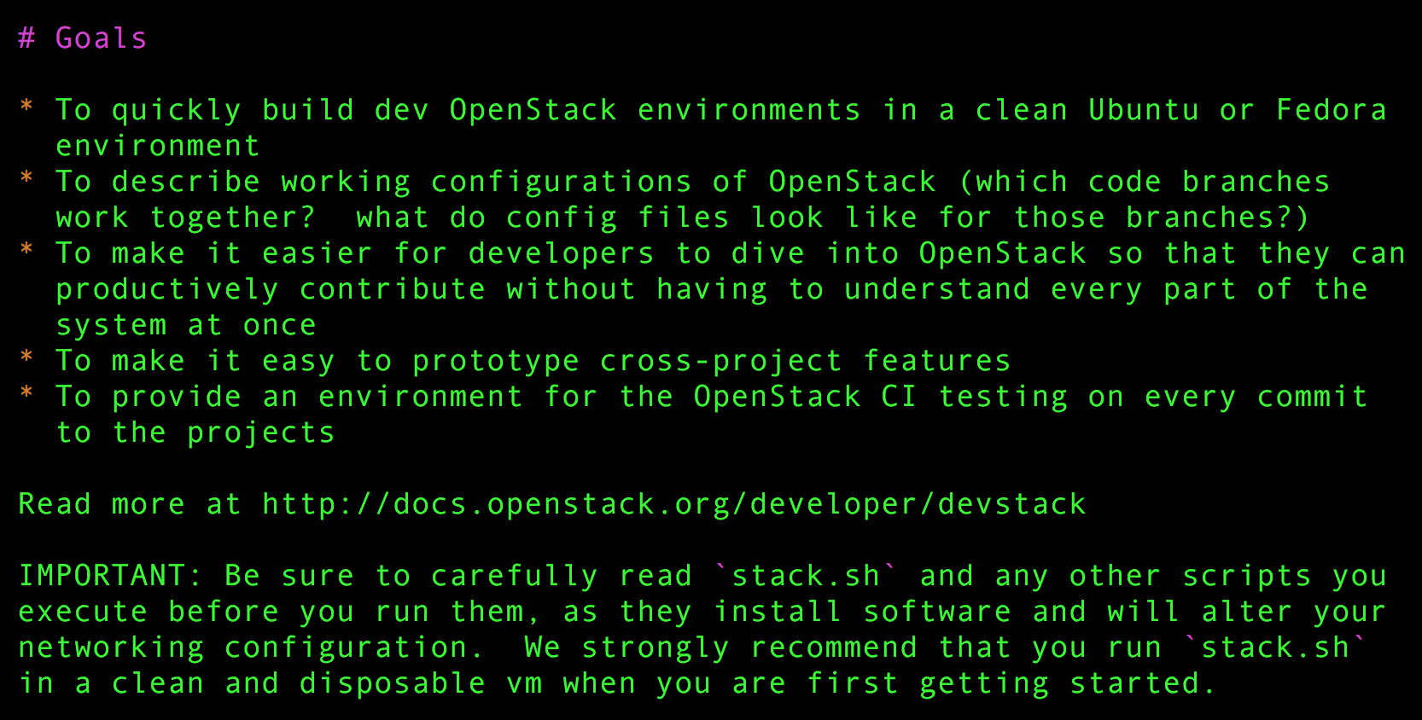
Goals of Devstack

Slide 12
Goals of Devstack

Slide 13
Goals of Devstack

Slide 14
Devstack download
$ git clone -b stable/liberty \ git://github.com/openstack-dev/devstack.git

Slide 15
Installation command (all in one)
$ ./stack.sh

Slide 16
distro problem

Slide 17
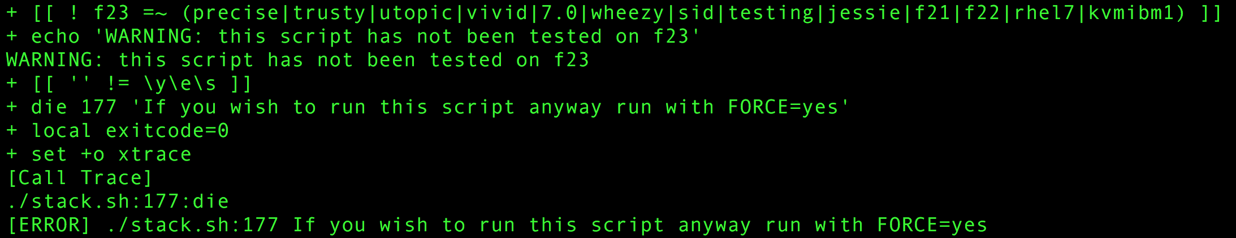
Distro problem

Slide 18
Spec of computer for research

Slide 19
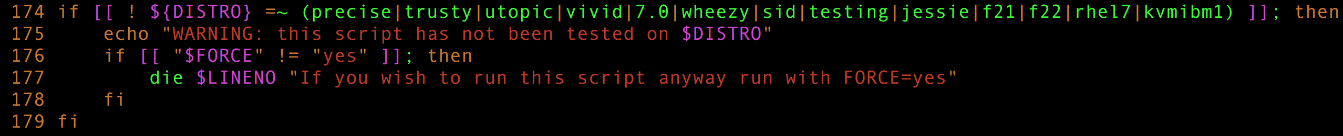
distro problem

Slide 20
distro problem

Slide 21
Supportive Distros for devstack 2016 / 04 / 19
precise, trusty, utopic, vivid = ubuntu 12.04, 14.04, 14.10, 15.04
7.0, wheezy, sid, testing, jessie = debian (7.0 = wheezy), (unstable = testing), 8.0
F21, f22 = FedoraCore 21, 22
Rhel7 = RedHat Enterprise Linux 7.0
Kvmibm1 = KVM for IBM Z system

Slide 22
Version change

Slide 23
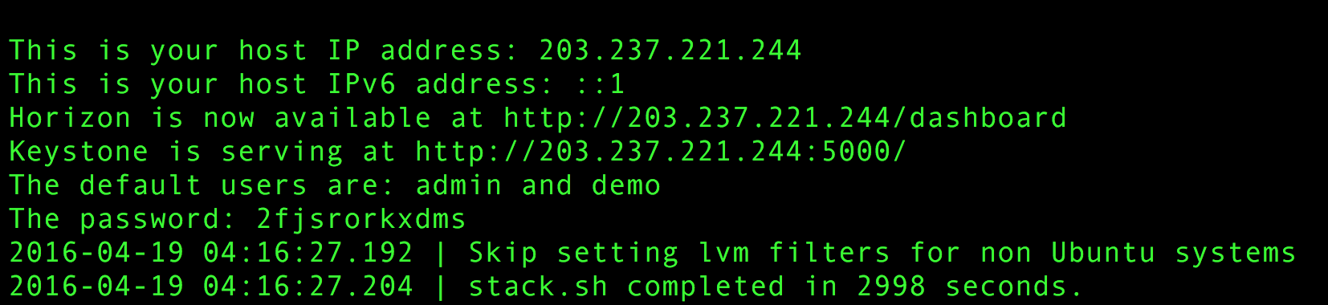
Installation success

Slide 24
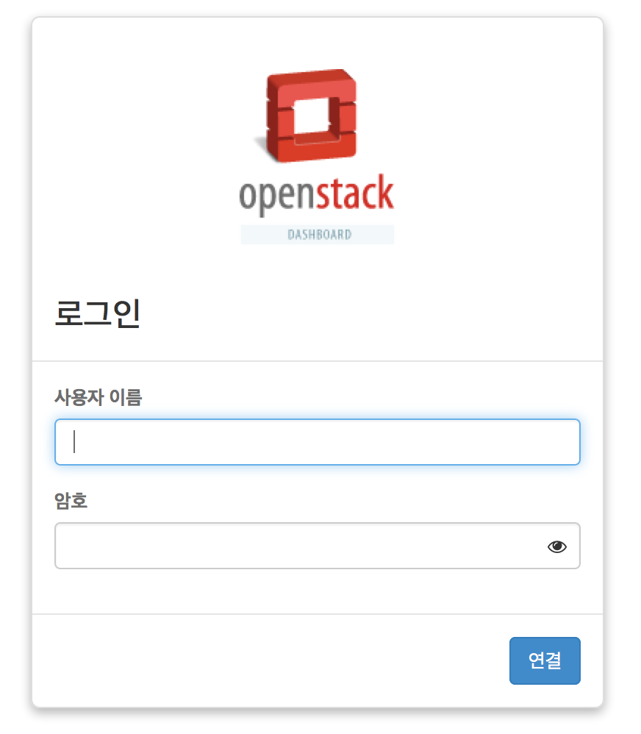
Installation success

Slide 25
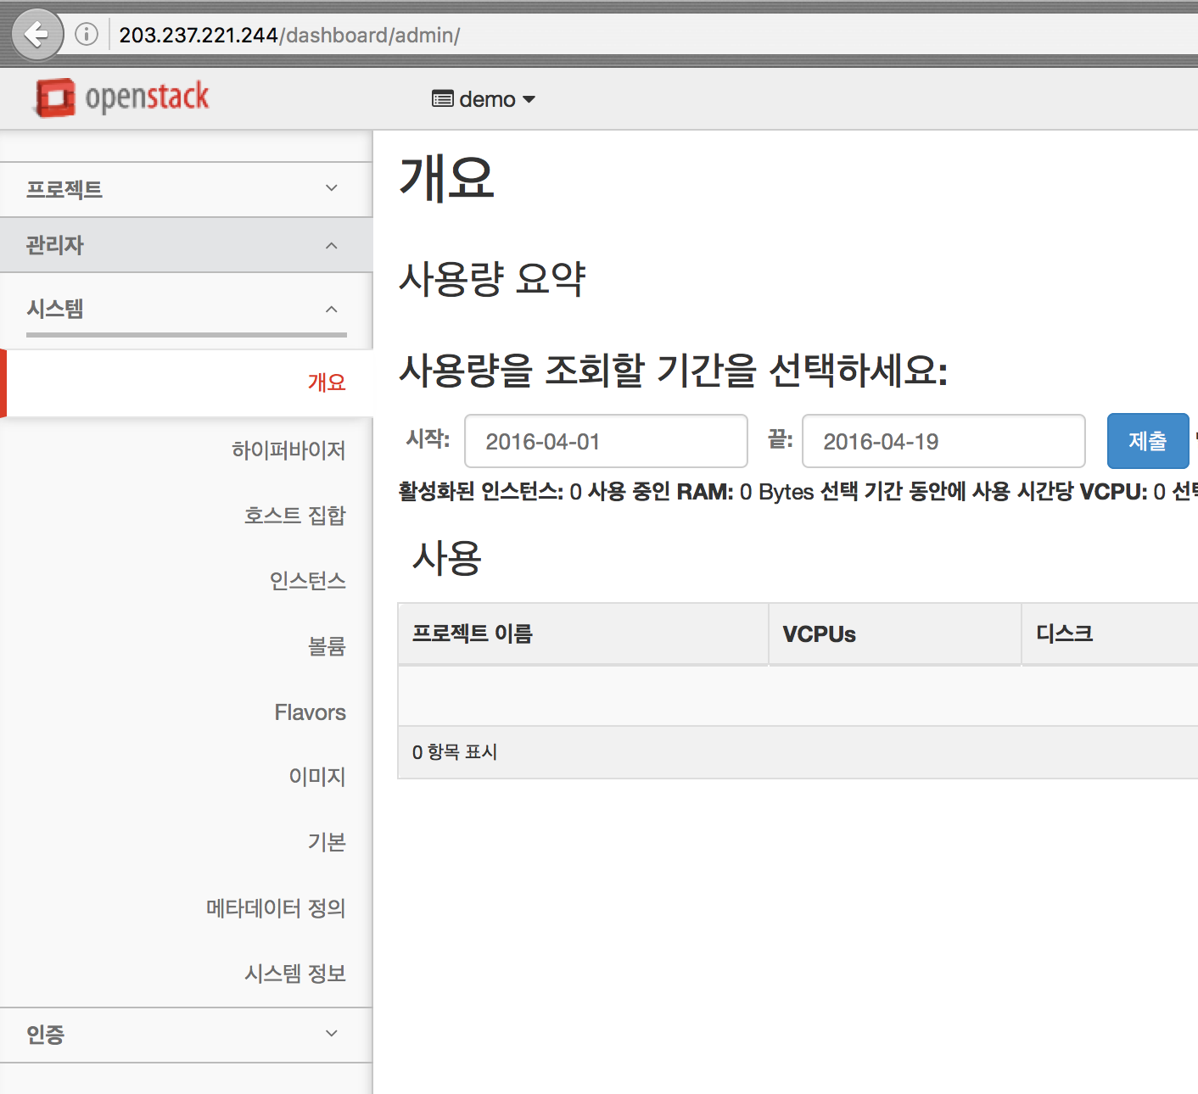

Slide 26
Configuration of devstack
http://docs.openstack.org/developer/devstack/configuration.html#openrc

Slide 27
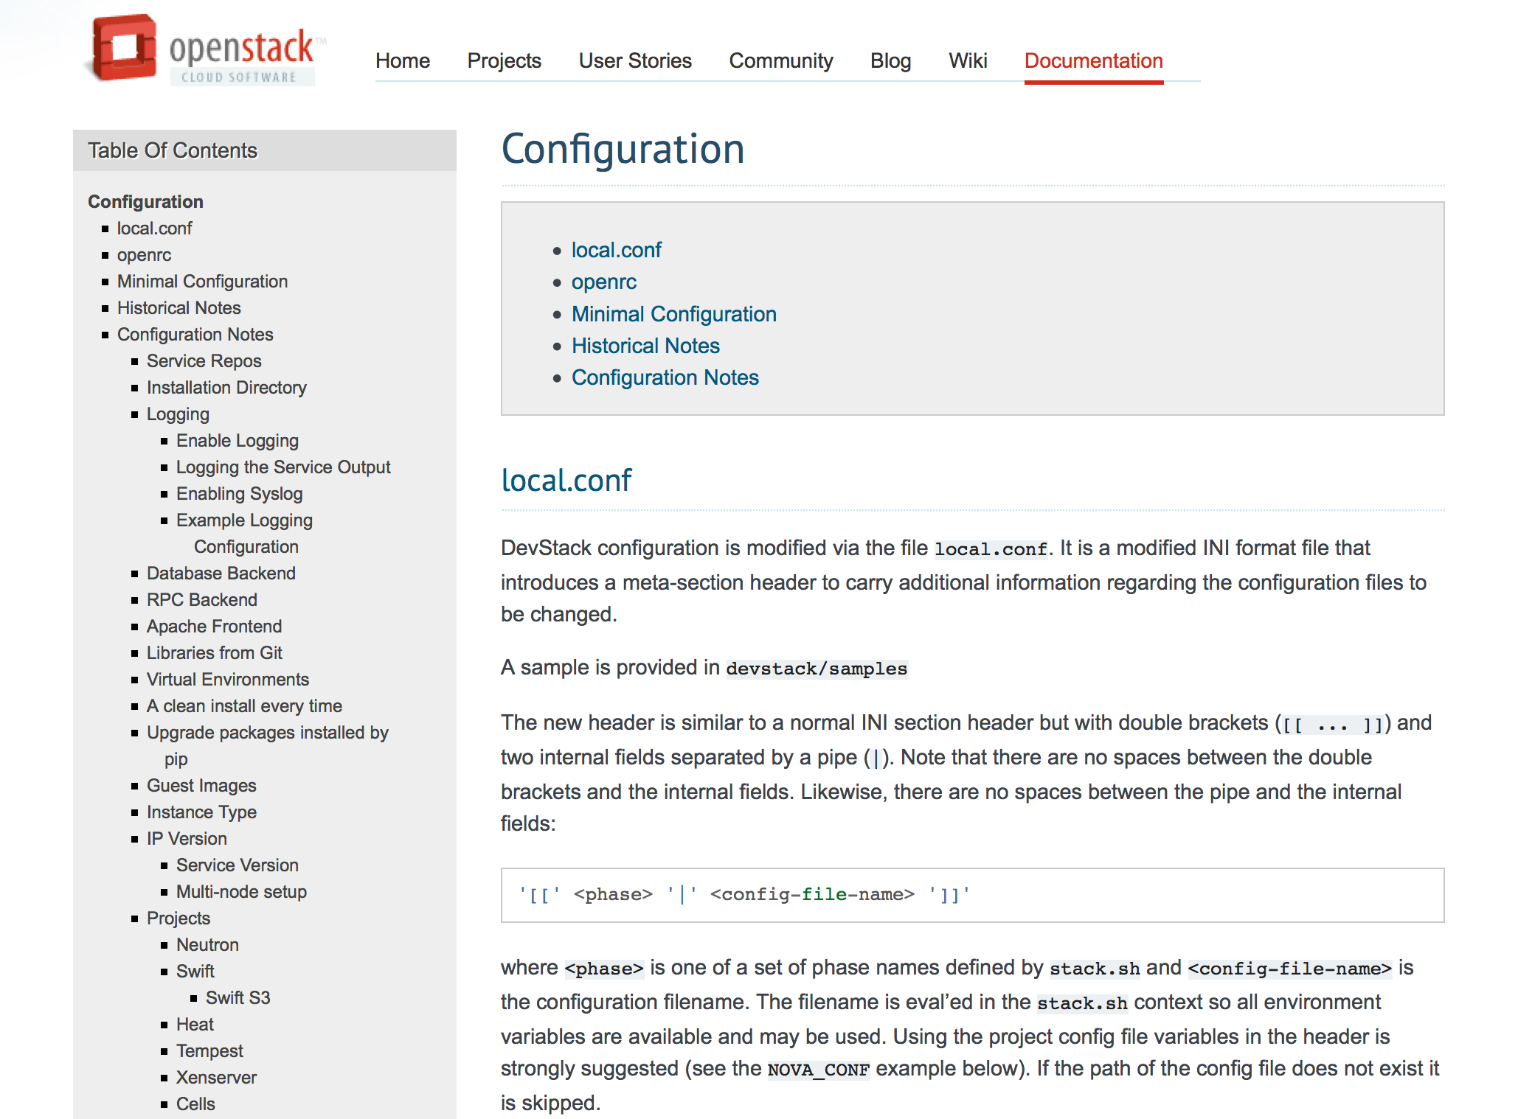
Option of devstack

Slide 28
Option of devstack

Slide 29
Local.conf
DevStack configuration is modified via the file local.conf
It is a modified INI format file that introduces a meta-section header to carry additional information regarding the configuration files to be changed.

Slide 30
Local.conf
DevStack configuration is modified via the file local.conf
It is a modified INI format file that introduces a meta-section header to carry additional information regarding the configuration files to be changed.

Slide 31
Local.conf
DevStack configuration is modified via the file local.conf
It is a modified INI format file that introduces a meta-section header to carry additional information regarding the configuration files to be changed.

Slide 32
INI file
The INI file format is an informal standard for configuration file for some platforms or software.
INI files are simple Text files with a Basic structure composed of sections, properties, and values

Slide 33
INI file
The INI file format is an informal standard for configuration file for some platforms or software.
INI files are simple Text files with a Basic structure composed of sections, properties, and values

Slide 34
INI file
The INI file format is an informal standard for configuration file for some platforms or software.
INI files are simple Text files with a Basic structure composed of sections, properties, and values

Slide 35
INI file
The INI file format is an informal standard for configuration file for some platforms or software.
INI files are simple Text files with a Basic structure composed of sections, properties, and values

Slide 36
Local.conf

Slide 37
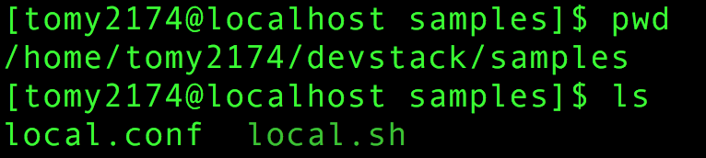
Local.conf

Slide 38
Local.conf

Slide 39
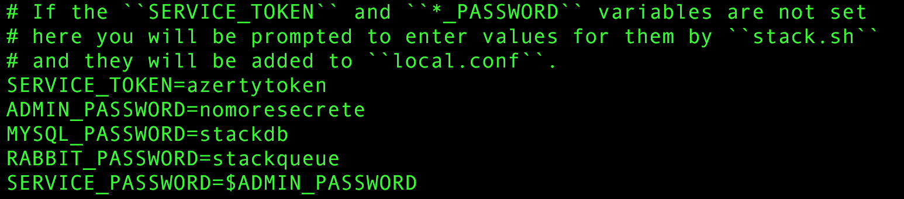
In the Middle of local.conf

Slide 40
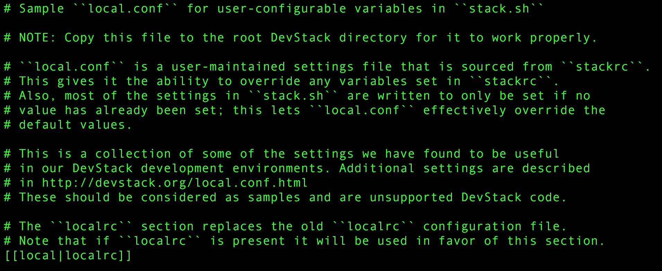
In local.conf

Slide 41
In local.conf

Slide 42
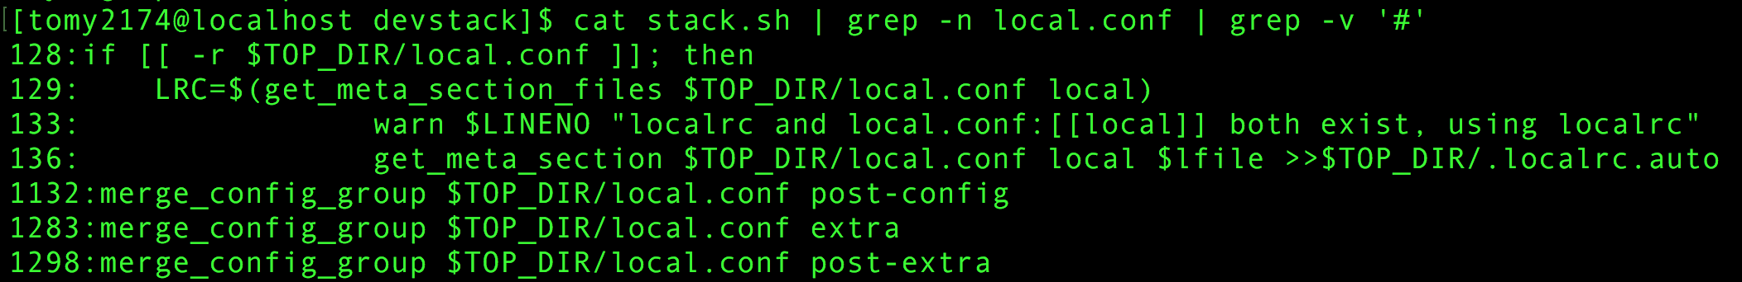
Stack.sh and local.conf

Slide 43
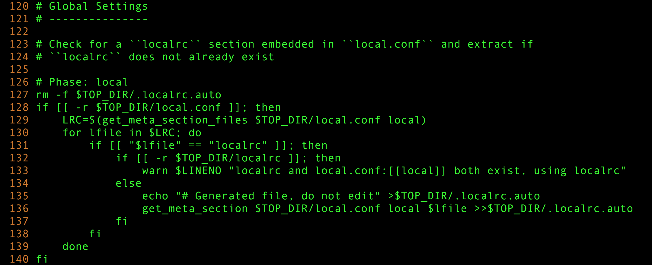
From 120th to 140th line in stack.sh

Slide 44
From 120th to 140th line in stack.sh

Slide 45
From 120th to 140th line in stack.sh

Slide 46
From 120th to 140th line in stack.sh

Slide 47
From 120th to 140th line in stack.sh

Slide 48
From 120th to 140th line in stack.sh

Slide 49
From 120th to 140th line in stack.sh

Slide 50
From 120th to 140th line in stack.sh

Slide 51
From 120th to 140th line in stack.sh

Slide 52
From 120th to 140th line in stack.sh

Slide 53
From 120th to 140th line in stack.sh

Slide 54
Local.conf is not working

Slide 55
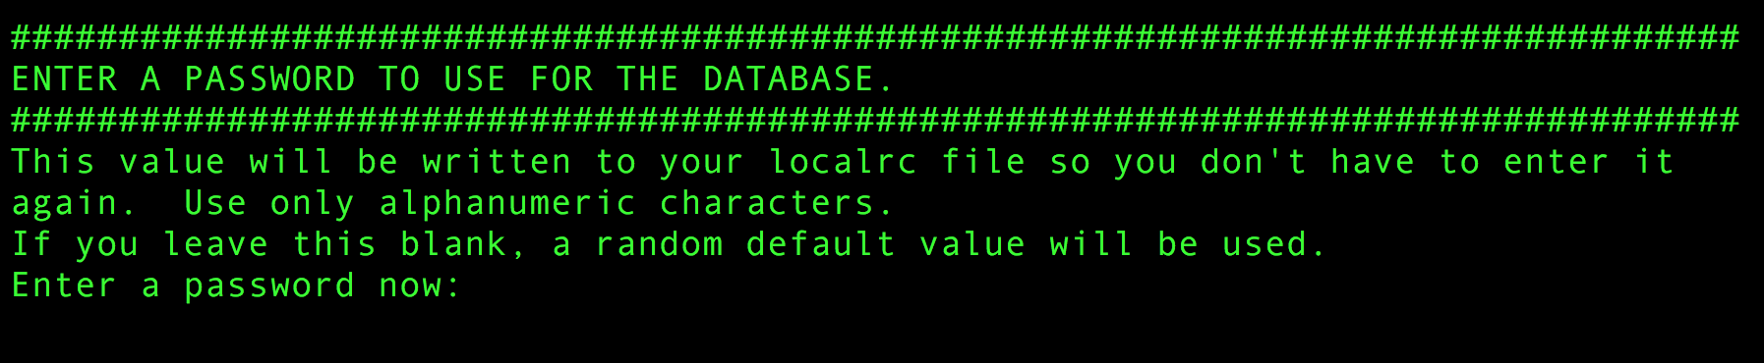
Local.conf is not working

Slide 56
my way to solve the problem

Slide 57
Standard way

Slide 58
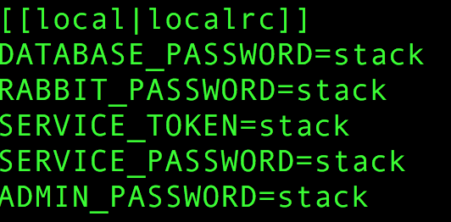
Standard way

Slide 59
Standard way

Slide 60
brackets at configuration file
The new header is similar to a normal INI section header but with double brackets ([[ ... ]]) and two internal fields separated by a pipe (|). Note that there are no spaces between the double brackets and the internal fields. Likewise, there are no spaces between the pipe and the internal fields:
'[[' <phase> '|' <config-file-name> ']]’
where <phase> is one of a set of phase names defined by stack.sh and <config-file-name> is the configuration filename. The filename is eval’ed in the stack.sh context so all environment variables are available and may be used. Using the project config file variables in the header is strongly suggested (see the NOVA_CONF example below). If the path of the config file does not exist it is skipped.

Slide 61
brackets at configuration file
'[[' <phase> '|' <config-file-name> ']]’
where <phase> is one of a set of phase names defined by stack.sh and <config-file-name> is the configuration filename.

Slide 62
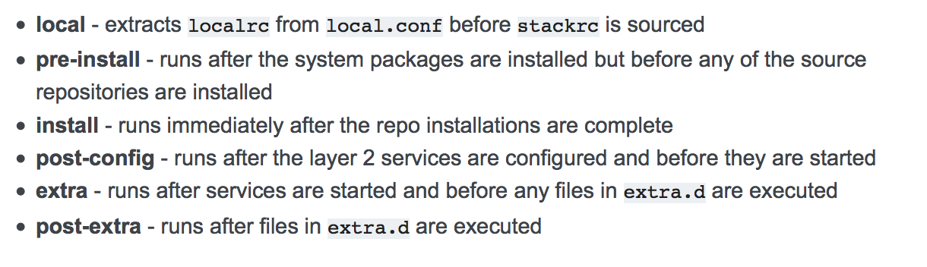
Installation Options at local.conf

Slide 65
In stack.sh and local.conf
LRC=$(get_meta_section_files $TOP_DIR/local.conf local)
[[local|localrc]]
DATABASE_PASSWORD=stack
RABBIT_PASSWORD=stack
SERVICE_TOKEN=stack
SERVICE_PASSWORD=stack
ADMIN_PASSWORD=stack

Slide 66
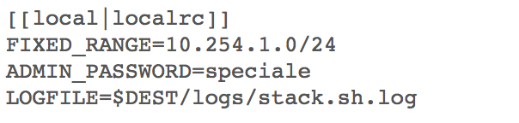
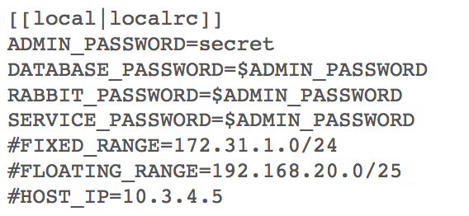
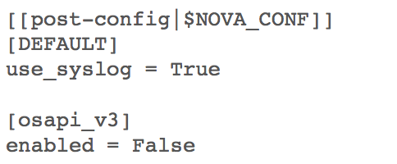
other options

Slide 67
OpenRC

Slide 68
openrc
openrc configures login credentials suitable for use with the OpenStack command-line tools. openrc sources stackrc at the beginning (which in turn sources the localrc section of local.conf) in order to pick up HOST_IP and/or SERVICE_HOST to use in the endpoints. The values shown below are the default values.

Slide 69
openrc
openrc configures login credentials suitable for use with the OpenStack command-line tools. openrc sources stackrc at the beginning (which in turn sources the localrc section of local.conf) in order to pick up HOST_IP and/or SERVICE_HOST to use in the endpoints. The values shown below are the default values.

Slide 70
openrc

Slide 71



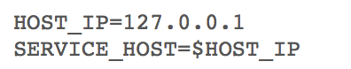
Options at openrc

Slide 72
Deep configuration for devstack

Slide 73
Deep configure for devstack
stackrc

Slide 74
Stackrc

Slide 75
Stackrc in stack.sh

Slide 76
Line number of stackrc

Slide 77
Into stackrc

Slide 78
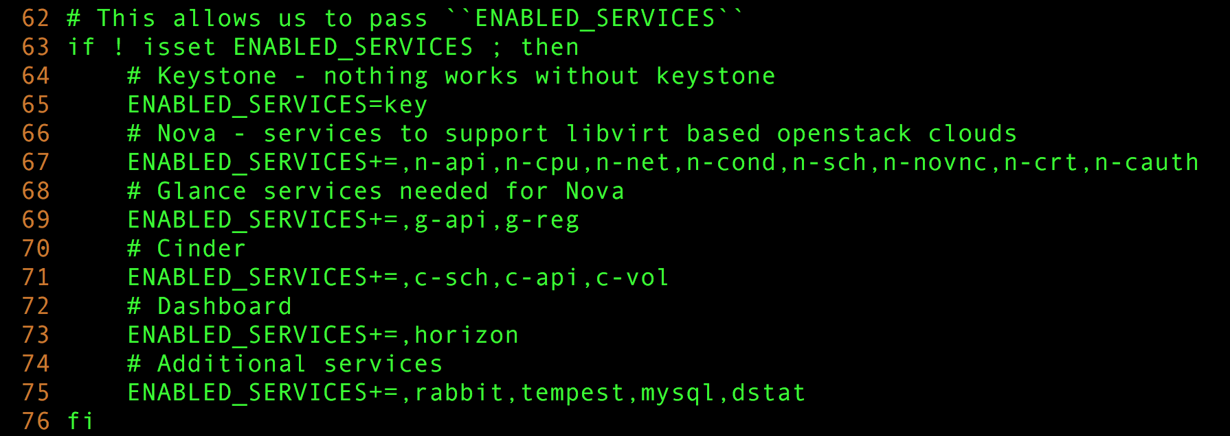
Into stackrc

Slide 79
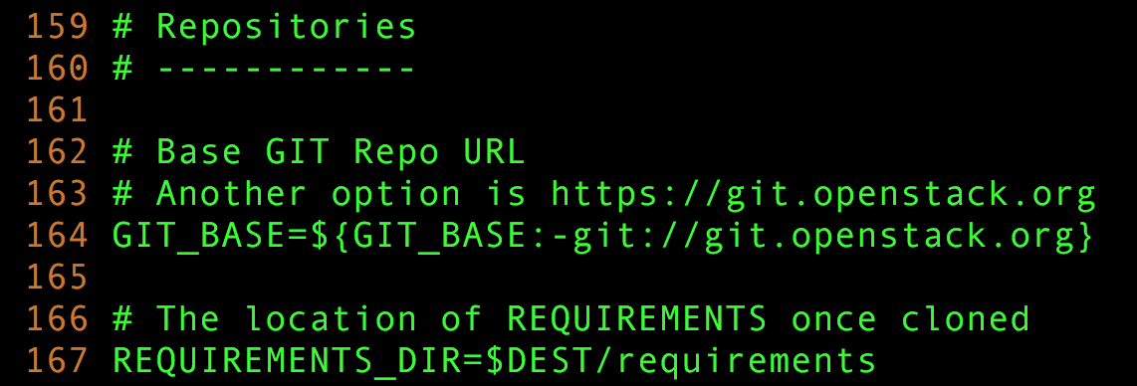
Into stackRC

Slide 80
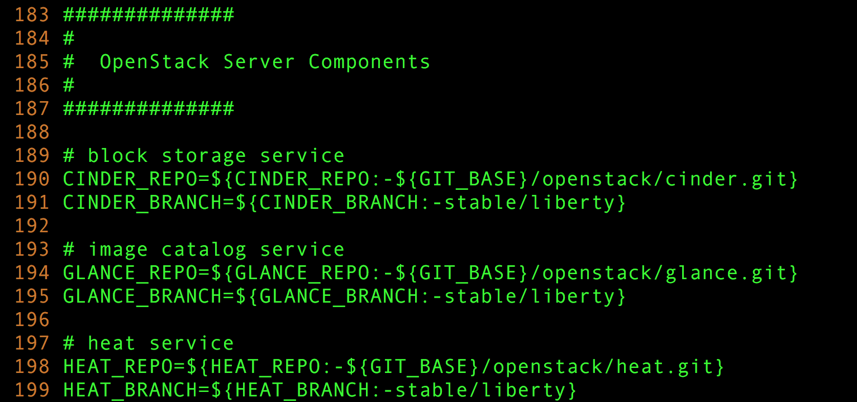
Into stackrc

Slide 81
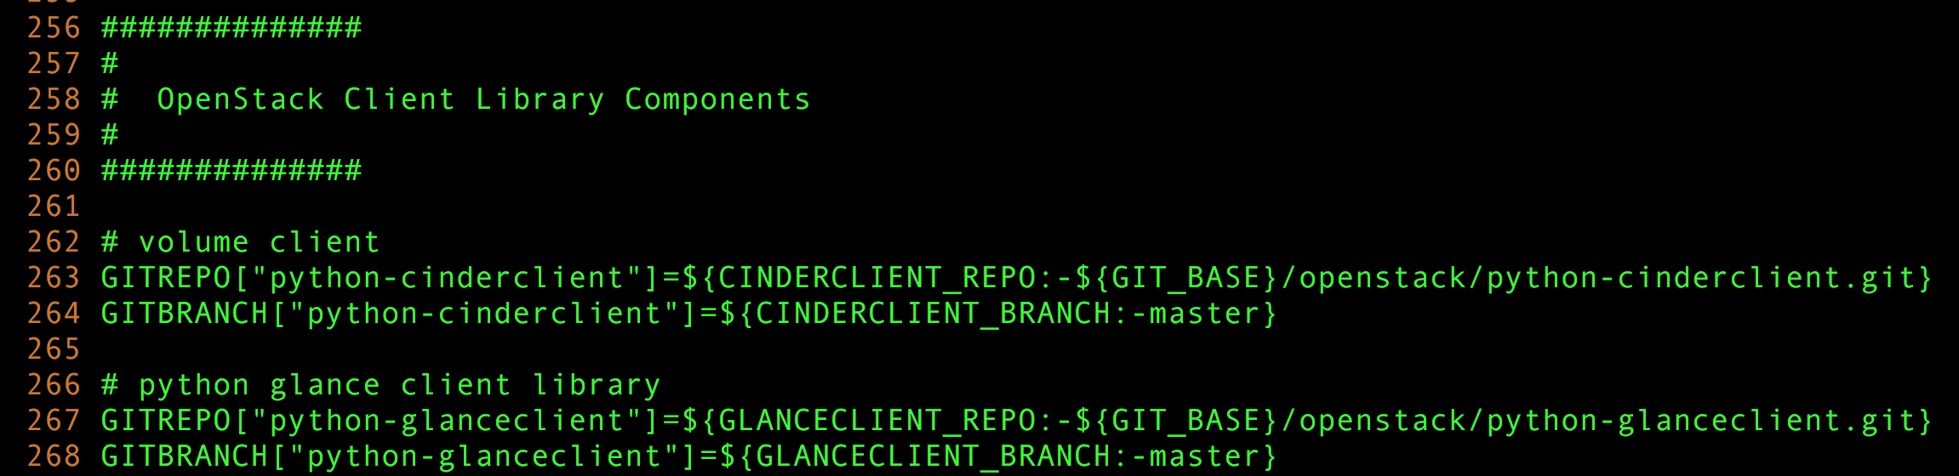
Into stackrc

Slide 82
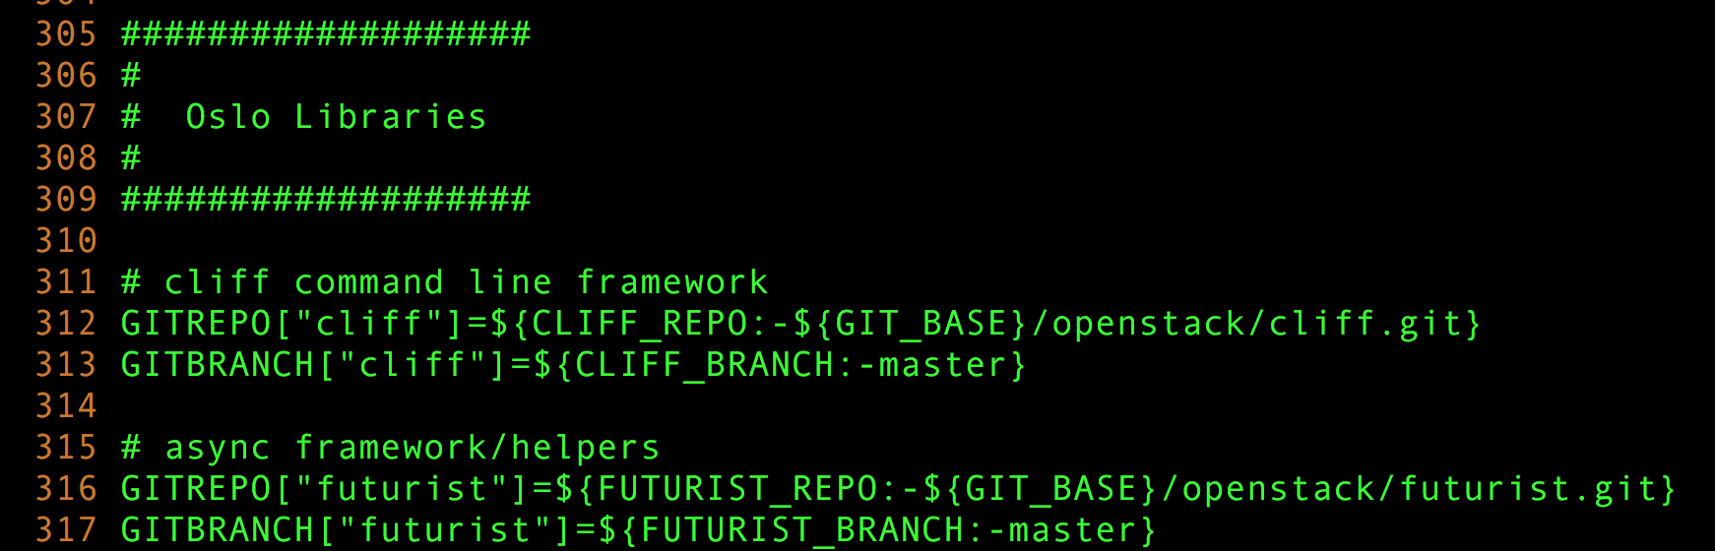
Into stackrc

Slide 83
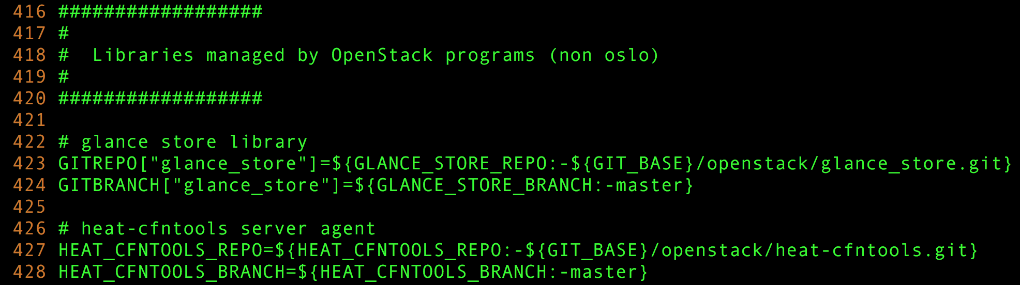
Into stackrc

Slide 84
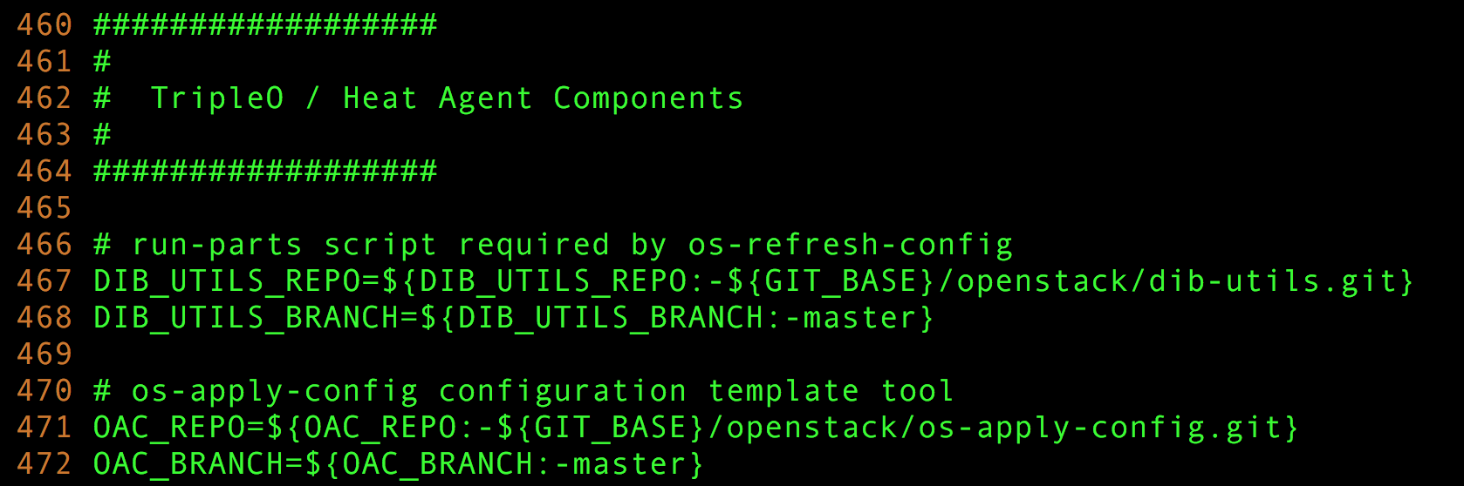
Into stackrc

Slide 85
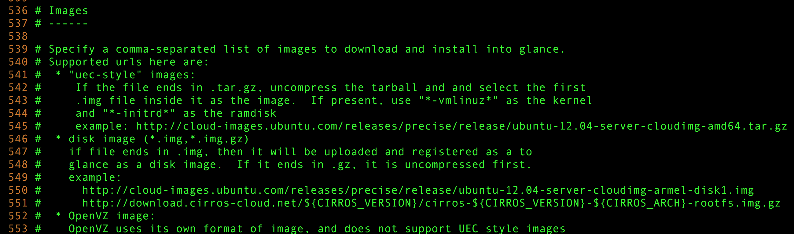
Into stackrc

Slide 86
stackrc

Slide 87
stackrc
Each component & image download (from online) control
Each component control
Many kind of library of devstack control
ETC….

Slide 88
Multiple node by devstack

Slide 89
Multiple node by devstack
http://docs.openstack.org/developer/devstack/guides/multinode-lab.html

Slide 90
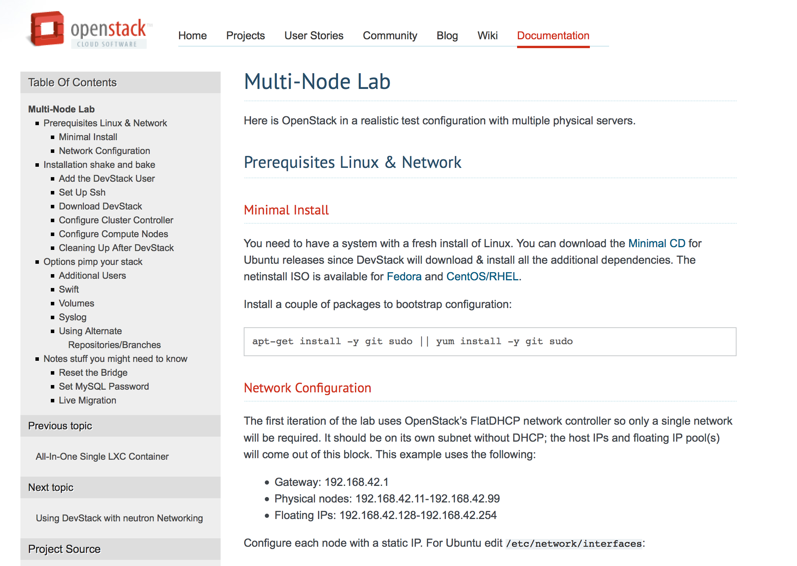
Multiple node by devstack
http://docs.openstack.org/developer/devstack/guides/multinode-lab.html

Slide 91
Structure of Multiple node by devstack

Slide 92
Structure of Multiple node by devstack
Cluster Controller
Compute Node
Compute Node
Compute Node

Slide 93
Configure at controller node

Slide 94
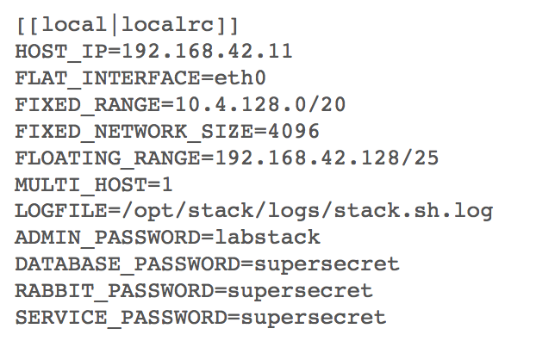
Configure at controller node

Slide 95
Configure at compute node

Slide 96
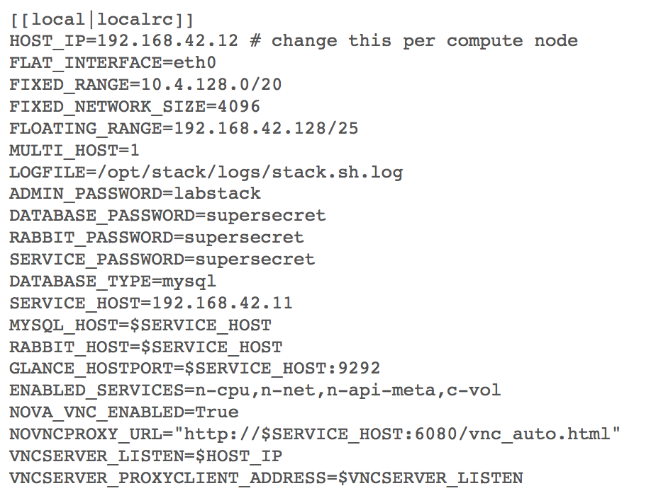
Configure at compute node

Slide 97
Configure at compute node

Slide 98
Some tips on devstack

Slide 99
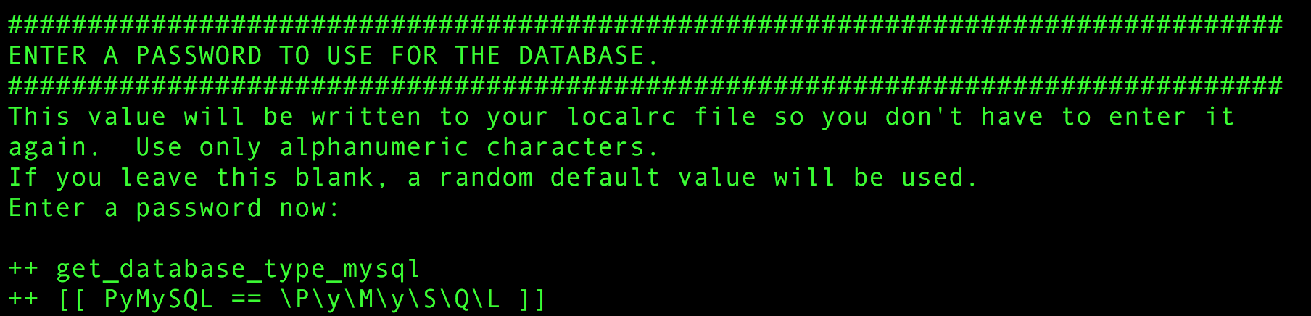
If input of password is skipped

Slide 100
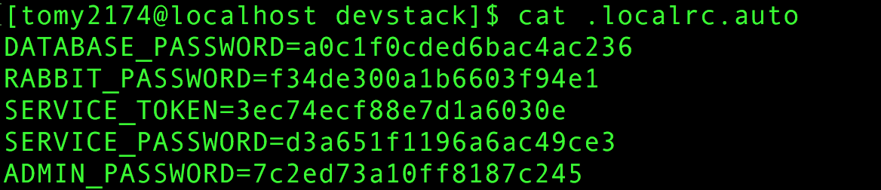
P/w is Automatically generated

Slide 101
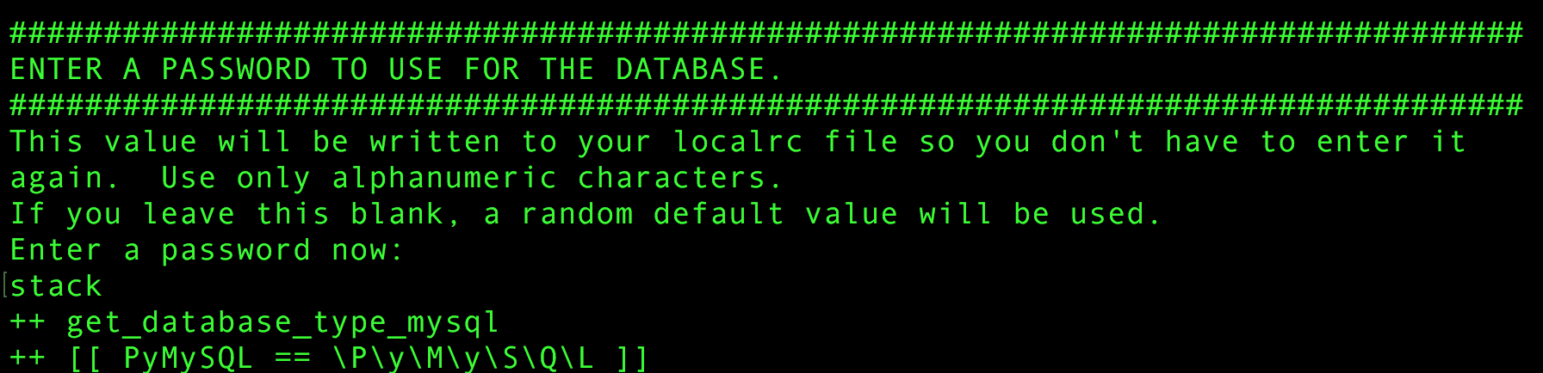
When I forget password

Slide 102
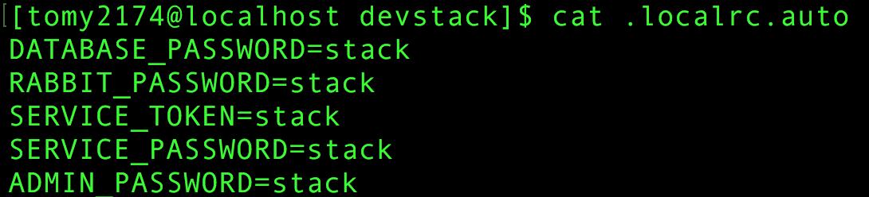
When I forget password

Slide 103
Small information In stackrc

Slide 104
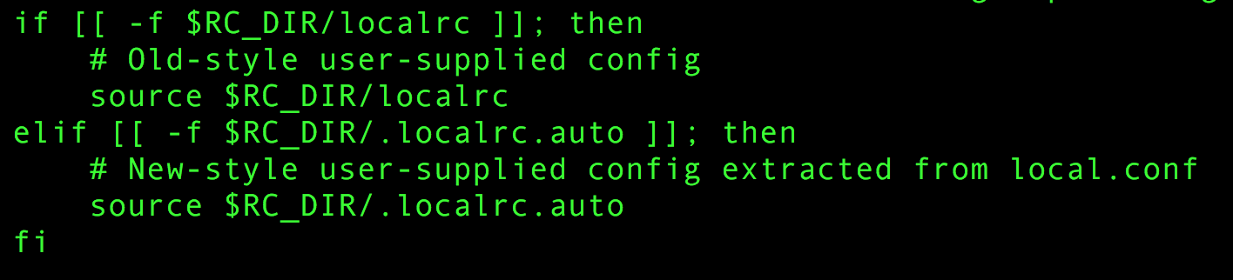
Small information In stackrc

Slide 105
Useful websites for devstack
Configuration
http://docs.openstack.org/developer/devstack/configuration.html#openrc
Multiple node
http://docs.openstack.org/developer/devstack/guides/multinode-lab.html

Slide 106
packstack?

Slide 107
Packstack

Slide 108

packstack

Slide 109
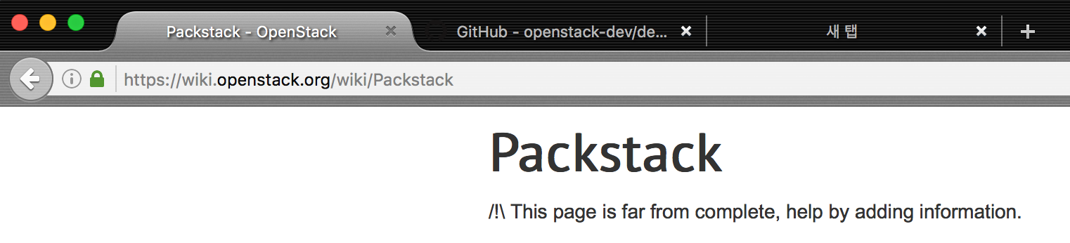
packstack

Slide 110
packstack
Utility that uses Puppet modules to deploy various parts of OpenStack on Multiple pre-installed servers over SSH automatically.
Currently only Fedora, Redhat Enterprise Linux (RHEL) and compatible derivatives of both are supported

Slide 111
packstack
Utility that uses Puppet modules to deploy various parts of OpenStack on Multiple pre-installed servers over SSH automatically.
Currently only Fedora, Redhat Enterprise Linux (RHEL) and compatible derivatives of both are supported

Slide 112
Puppet

Slide 113
Puppet
Puppet is an open-source configuration management tool.
It runs on many Unix-like systems as well as on Microsoft Windows, and includes its own declarative language to describe system configuration.
It is written in Ruby and released as free software under the GNU General Public License (GPL) until version 2.7.0 and the Apache License 2.0 after that.

Slide 114
packstack
Utility that uses Puppet modules to deploy various parts of OpenStack on Multiple pre-installed servers over SSH automatically.
Currently only Fedora, Redhat Enterprise Linux (RHEL) and compatible derivatives of both are supported

Slide 115
packstack
Utility that uses Puppet modules to deploy various parts of OpenStack on Multiple pre-installed servers over SSH automatically.
Currently only Fedora, Redhat Enterprise Linux (RHEL) and compatible derivatives of both are supported

Slide 116
Packstack mode
All in One
Controller / multiple compute nodes
Swift Proxy / Multiple Storage Devices

Slide 117
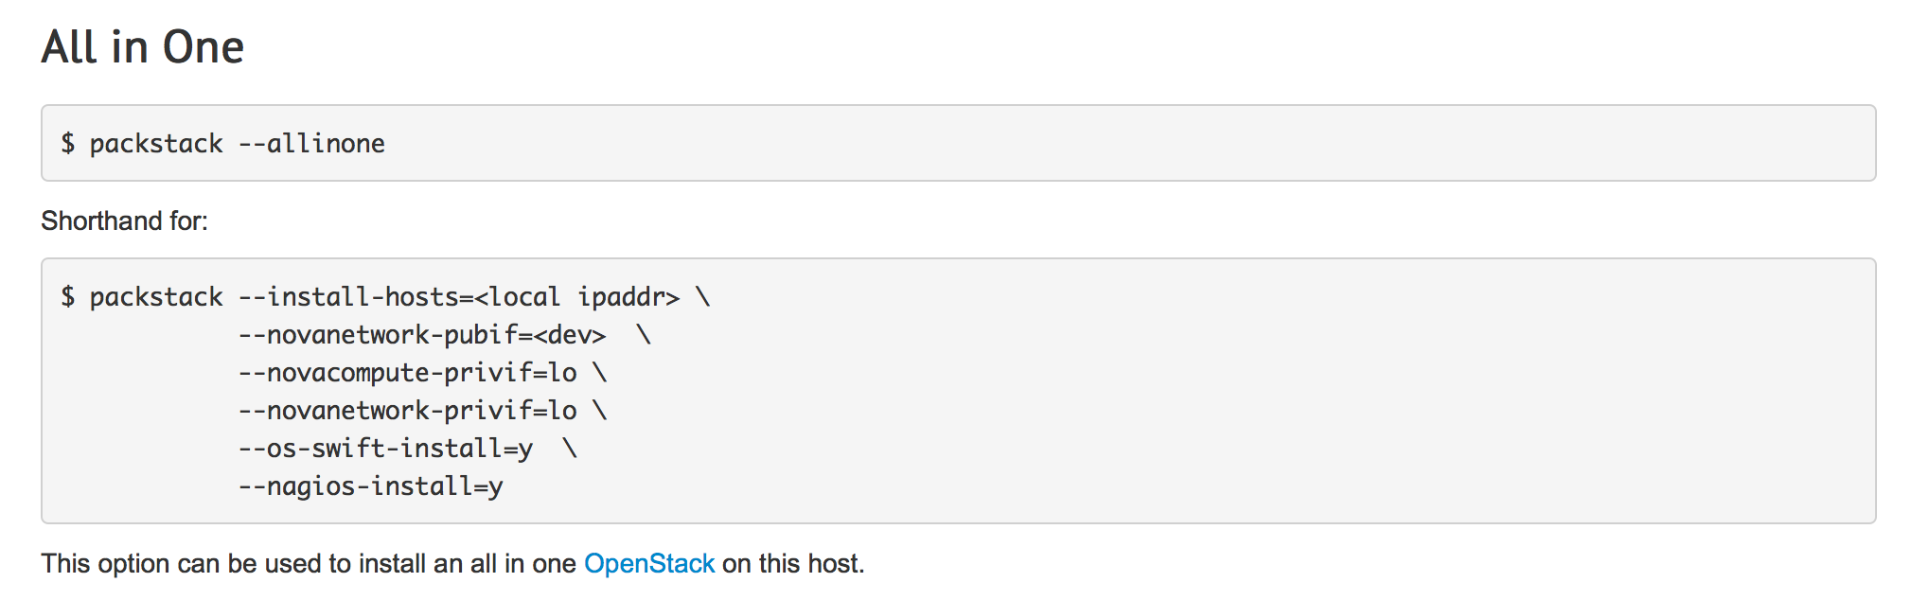
All in One at packstack

Slide 118
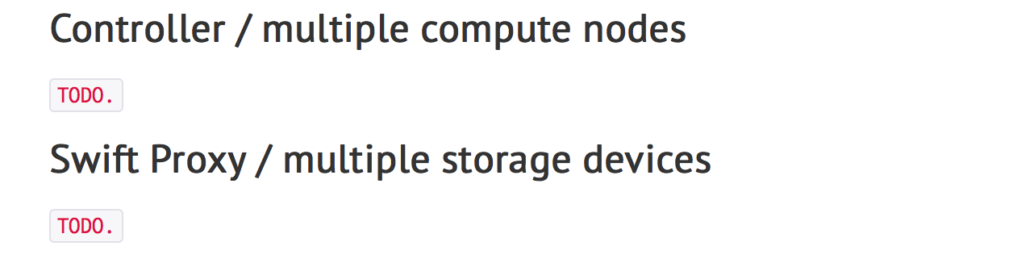
Others at openstack

Slide 119
Packstack installation
$ git clone -b stable/liberty \ git://github.com/openstack/packstack.git

Slide 120
Configuration of packstack
$ packstack --gen-answer-file=answers.txt

Slide 121
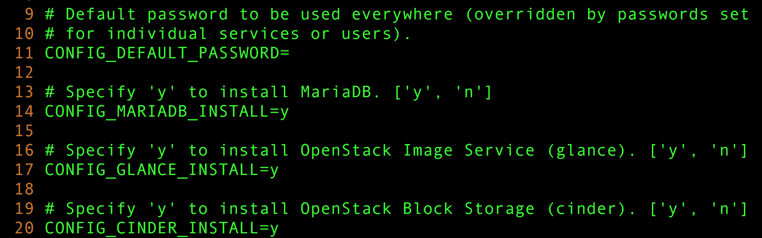
Answers file
$ packstack --gen-answer-file=answers.txt

Slide 122
Packstack installation
$ sudo python setup.py install

Slide 123
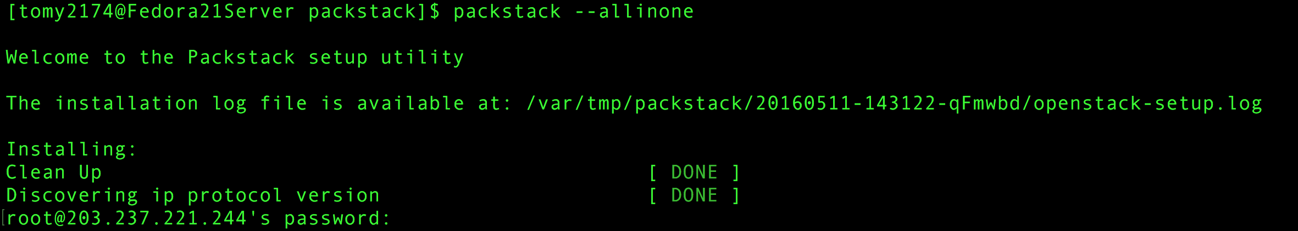
Root password

Slide 124
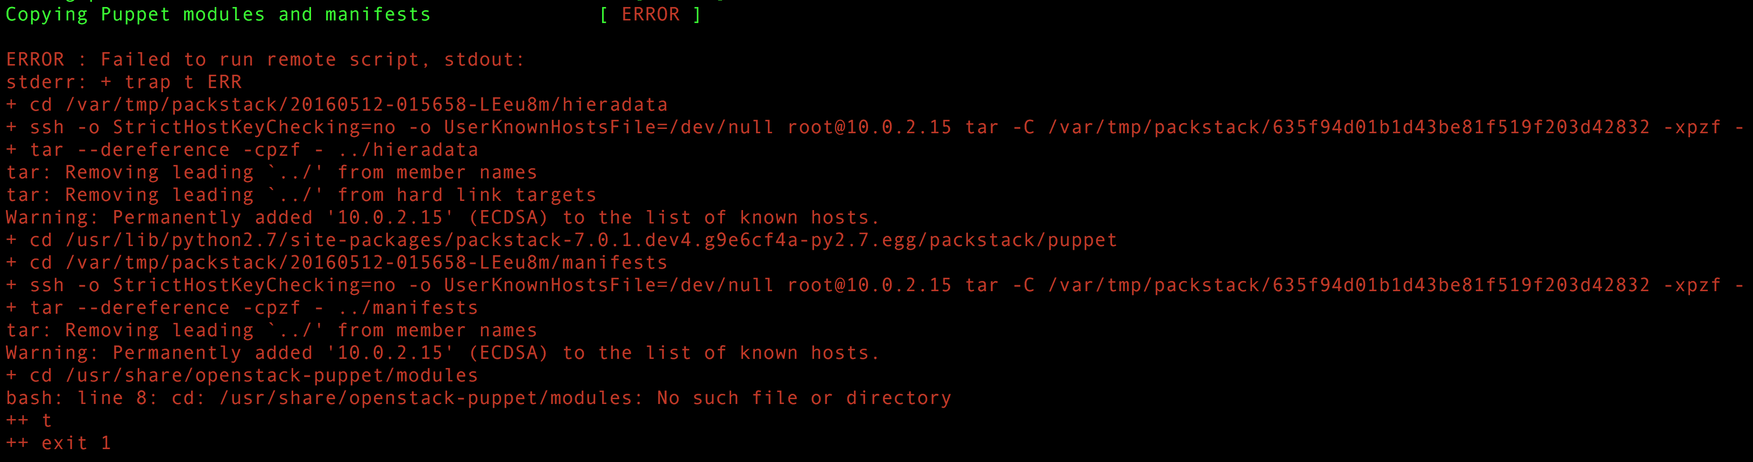
Failed packstack installation

Slide 125
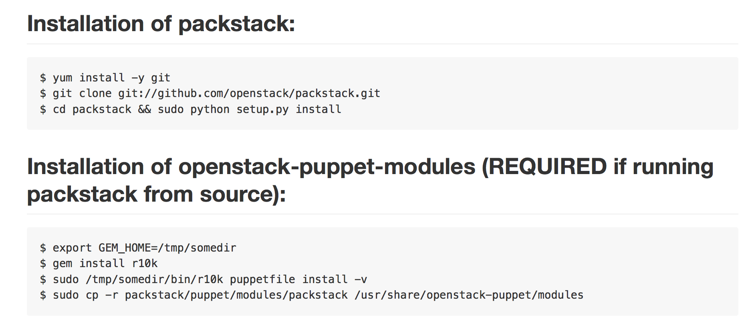
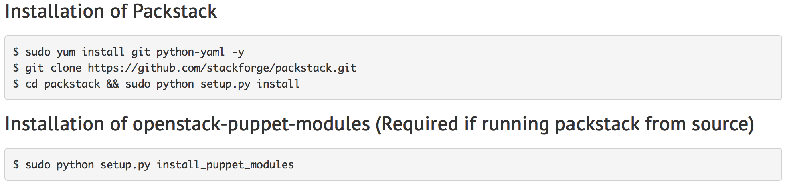
It’s different for installing way
On github
On openstack wiki

Slide 126
Unknown error

Slide 127
Reboot and try installation again

Slide 128
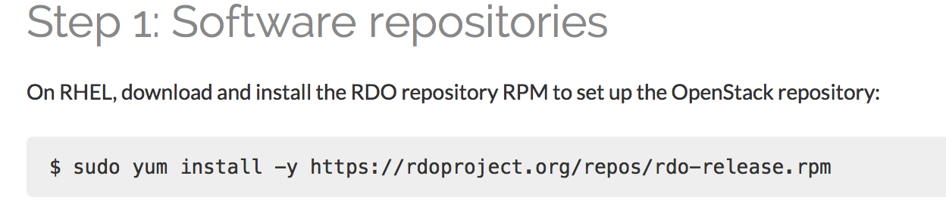
Another installation way 1

Slide 129
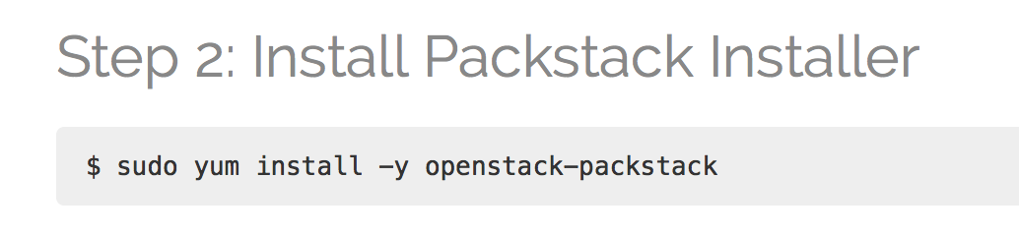
Another installation way 2

Slide 130
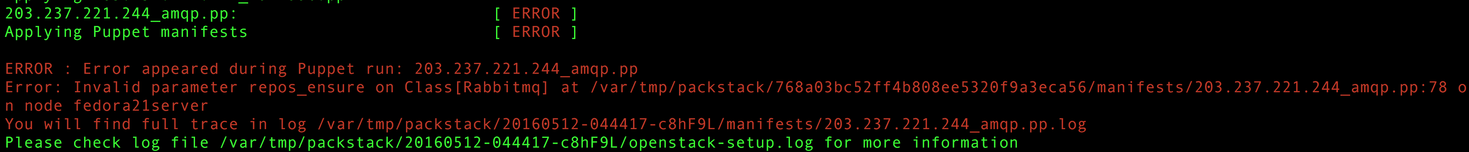
Another error is appeared

Slide 131


Weakness of packstack

Slide 132
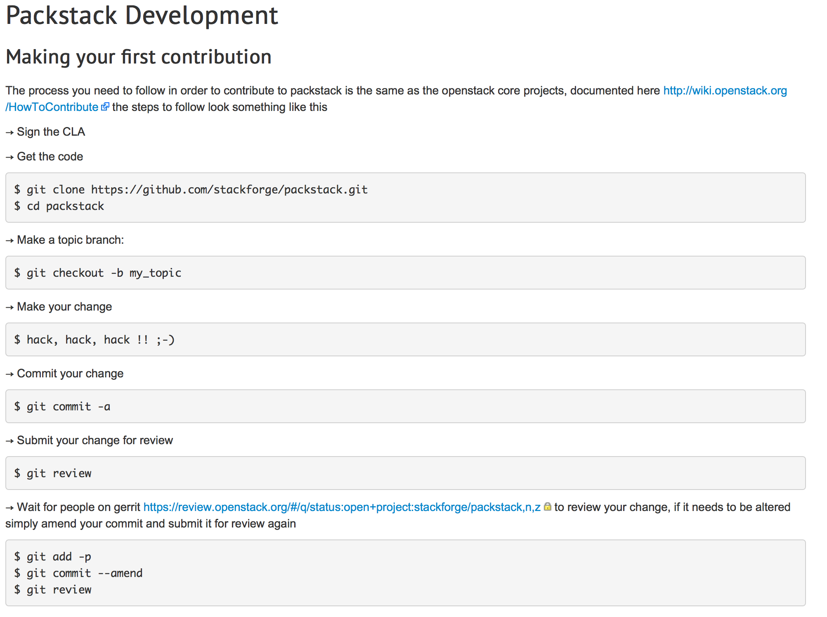

Slide 133
Reference website for installation packstack
Rdoproject.org
Github
Openstack wiki

Slide 134
Advantage of devstack
Much data & information
Runnable on more kind of distro
easy to understand

Slide 135
Advantage of packstack
If It gets more completed, management will be easier
Easy configuration and not too long initial install time

Slide 137
Funny things

Slide 138
Supporting Distros of devstack

Slide 139
Supportive Distros for devstack 2016 / 04 / 19
precise, trusty, utopic, vivid = ubuntu 12.04, 14.04, 14.10, 15.04
7.0, wheezy, sid, testing, jessie = debian (7.0 = wheezy), (unstable = testing), 8.0
F21, f22 = FedoraCore 21, 22
Rhel7 = RedHat Enterprise Linux 7.0
Kvmibm1 = KVM for IBM Z system

Slide 140
Supportive Distros for devstack 2016 / 04 / 19
precise, trusty, utopic, vivid = ubuntu 12.04, 14.04, 14.10, 15.04
7.0, wheezy, sid, testing, jessie = debian (7.0 = wheezy), (unstable = testing), 8.0
F21, f22 = FedoraCore 21, 22
Rhel7 = RedHat Enterprise Linux 7.0
Kvmibm1 = KVM for IBM Z system

Slide 141
Supportive Distros for devstack 2016 / 04 / 19
?
precise, trusty, utopic, vivid = ubuntu 12.04, 14.04, 14.10, 15.04
7.0, wheezy, sid, testing, jessie = debian (7.0 = wheezy), (unstable = testing), 8.0
F21, f22 = FedoraCore 21, 22
Rhel7 = RedHat Enterprise Linux 7.0
Kvmibm1 = KVM for IBM Z system

Slide 142
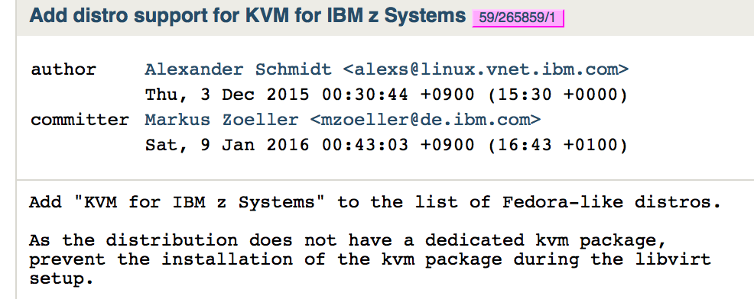
https://review.openstack.org/gitweb?p=openstack-dev/devstack.git;a=commitdiff;h=91eba8eb20019f998ef03b7bd553f66fc035cdaf

Slide 143
https://review.openstack.org/gitweb?p=openstack-dev/devstack.git;a=commitdiff;h=91eba8eb20019f998ef03b7bd553f66fc035cdaf

Slide 144
https://review.openstack.org/gitweb?p=openstack-dev/devstack.git;a=commitdiff;h=91eba8eb20019f998ef03b7bd553f66fc035cdaf

Slide 145
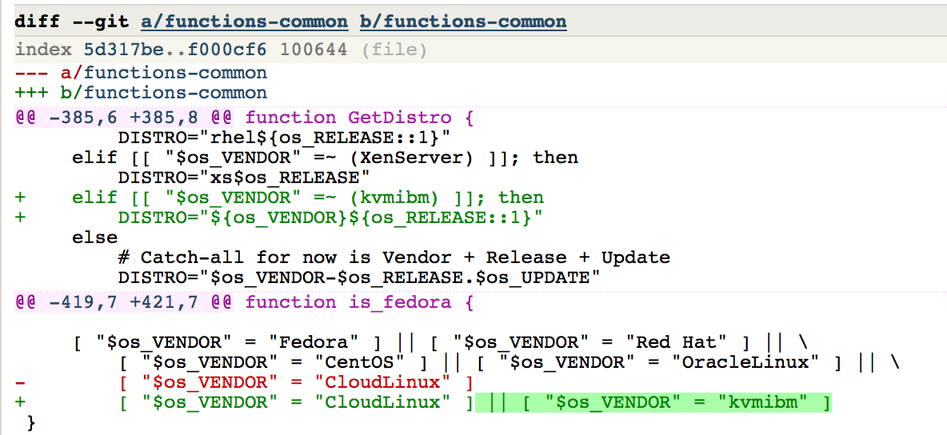

Slide 146
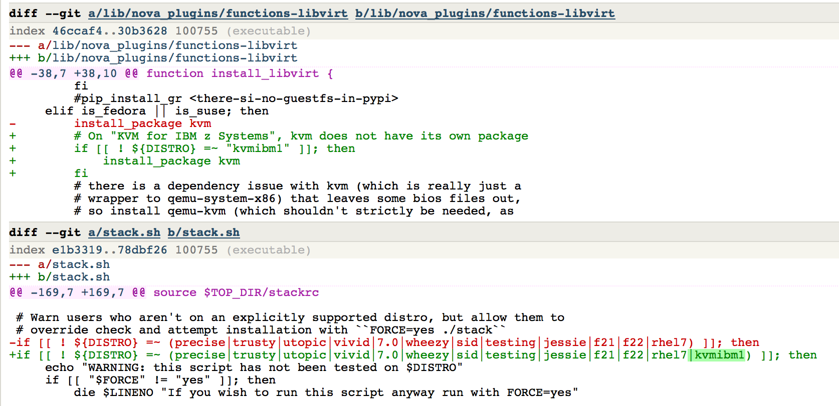

Slide 147


Slide 149

zSeries 800

Slide 150


Openstack and redhat

Slide 151
Q&A

